Slide 1



Slide 2

Price Discovery at Excessive Passive Indexing
Aim:
To determine whether there exists a tipping point in the size of passive
investing, beyond which stock mispricing cannot be corrected.
Contribution to Literature:
Market Ecology – How market ecology explains market malfunction, Scholl et al (2020).
Econometric analysis – indexing may inhibit price discovery.
Evolutionary Economics – Models of Natural selection on financial markets.
Model->
Data:
Bloomberg Terminal
- MSCI Large Cap., Medium Cap and Small Cap. Index
- S&P 500 Index
- Vanguard 500 Index
EPFR Fund Flows
13-F Fillings
Policy Implications:
Inform regulation on the safe limits of indexed wealth which a market should not
exceed to prevent potentially long-term economic inefficiency.
Inform investors on likely rate of an investment philosophy’s yield given a certain percentage of passive indexing
The Model
Passive Investor
Div. 1
Large-Cap. Stocks
Value Investor
Div. 2
Mid-Cap. Stocks
Growth Investor
Bond
Div. 3
Small-Cap. Stocks
Momentum Investor
Noise Trader

Slide 3
Order book Pricing Output

Slide 4
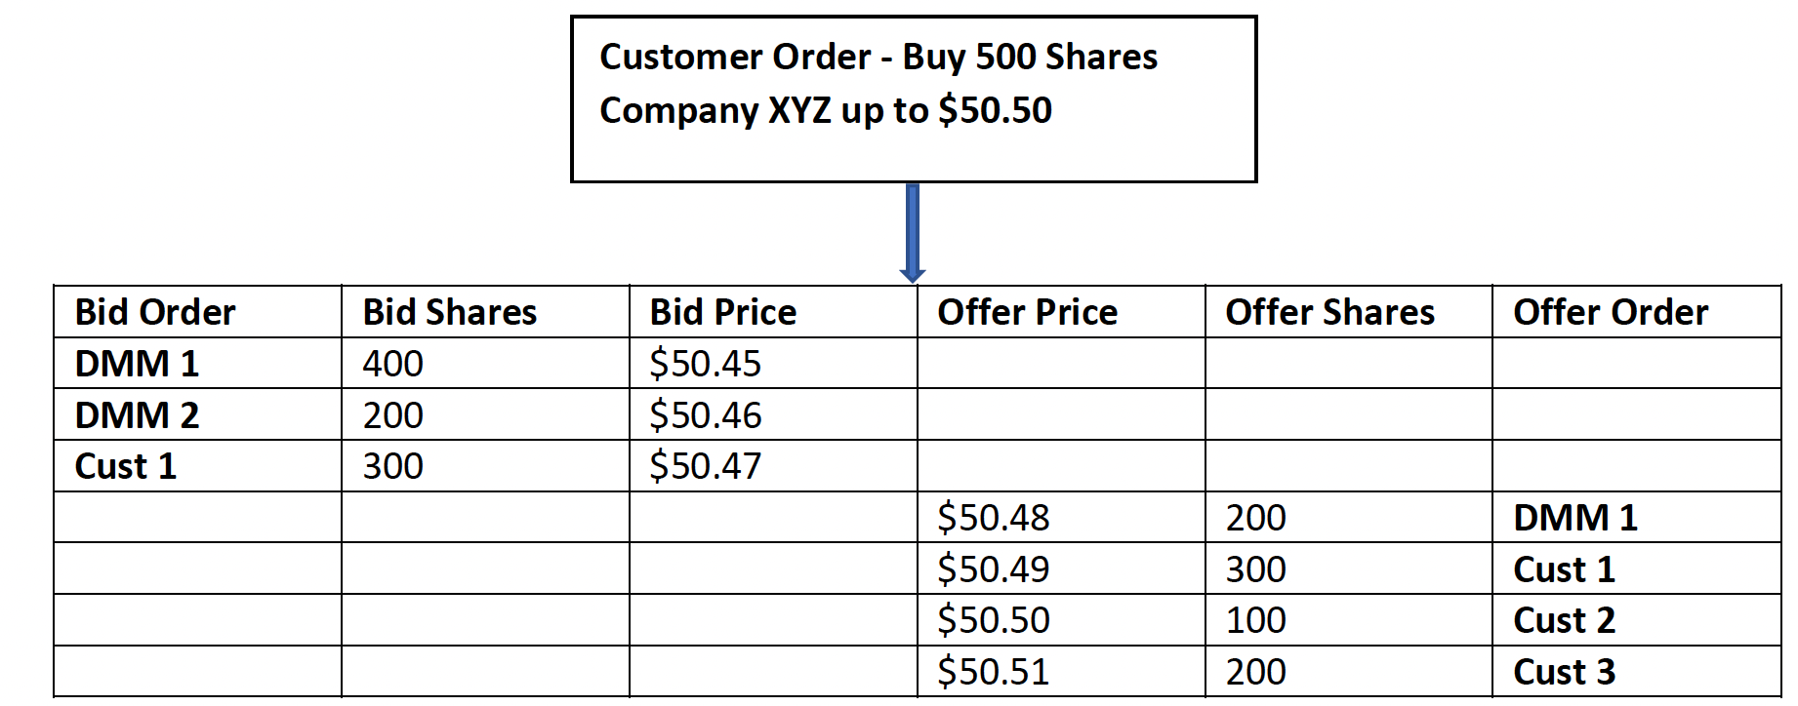
Price Setting
Steven W. Poser, (2021), Market Makers in Financial Markets: Their Role, How They Function,
Why They are Important, and the NYSE DMM Difference
Daniel Weaver, (2012) ,Minimum obligations of market makers

Slide 5
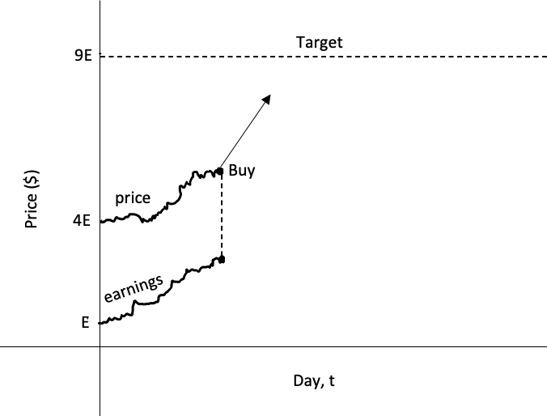
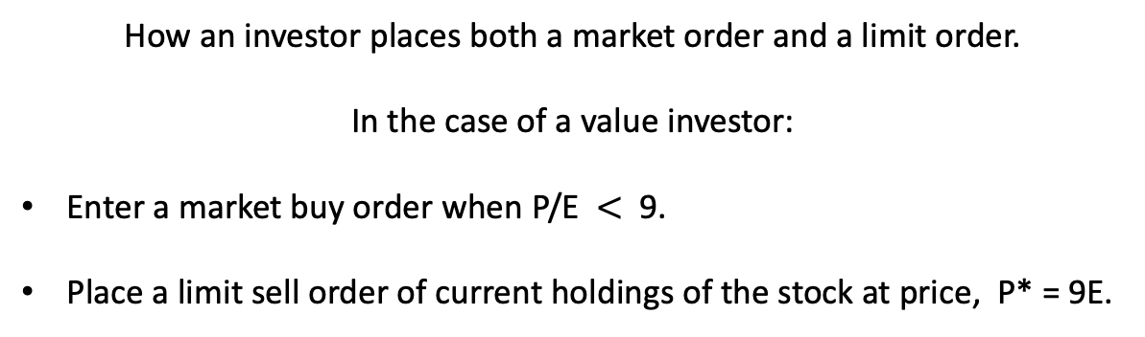

price
price
price
earnings
earnings
earnings
How an investor places both a market order and a limit order.
In the case of a value investor:
Enter a market buy order when P/E $<$9.
Place a limit sell order of current holdings of the stock at price, P* = 9E.

Slide 6

Calibration of salient points from EPFR Fund allocations data
$$φ$$

Slide 7
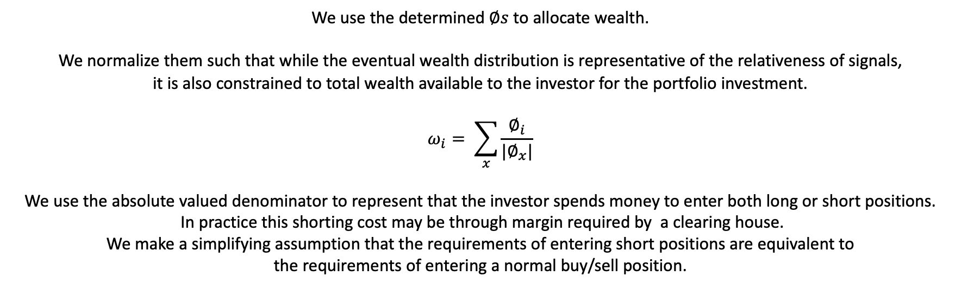



Normalizing Signals
$$φ$$
$$φ$$
$$φ$$
We use the determined $∅s$ to allocate wealth.
We normalize them such that while the eventual wealth distribution is representative of the relativeness of signals,
it is also constrained to total wealth available to the investor for the portfolio investment.
$$ω_{i}= \sum_{x}{\frac{∅_{i}}{|∅_{x}|}}$$
We use the absolute valued denominator to represent that the investor spends money to enter both long or short positions.
In practice this shorting cost may be through margin required by a clearing house.
We make a simplifying assumption that the requirements of entering short positions are equivalent to
the requirements of entering a normal buy/sell position.

